Slide 1
Huffman Coding
Team members:-
Disha Jain (19BCT0219)
Rachit Elhance(19BCT0187)
Rahul Chetan Thakar(19BCT0192)
Swayam Prakash Pati(19BCT0161)

Slide 2
Data Compression
Data compression is the process of modifying, encoding or converting the bits structure of data in such a way that it consumes less space on disk.
It enables reducing the storage size of one or more data instances or elements. Data compression is also known as source coding or bit-rate reduction.
Notes:
Lgdlp go

Slide 3
History of data compression:
Data compression has a history that predates physical computing. Morse code, for example, compresses information by assigning shorter codes to characters that are statistically common in the English language (such as the letters “e” and “t”). Huffman coding came about as the result of a class project at MIT by its then student, David Huffman.
This resulted in Huffman coding, which by the 1970s had become a prominent digital encoding algorithm

Slide 4
Huffman Coding:
Huffman coding is a lossless data encoding algorithm. The process behind its scheme includes sorting numerical values from a set in order of their frequency
Amongst all the techniques, Huffman codes are formulated to be an optimal code, i.e., they achieve the minimum average code length, which may still be greater than or equal to the length of source

Slide 5
There are mainly two major parts in Huffman Coding
1) Build a Huffman Tree from input characters.
2) Traverse the Huffman Tree and assign codes to characters.

Slide 6
Steps to build Huffman Tree
1. Create a leaf node for each unique character and build a min heap of all leaf nodes (Min Heap is used as a priority queue. The value of frequency field is used to compare two nodes in min heap. Initially, the least frequent character is at root)
2. Extract two nodes with the minimum frequency from the min heap.
3. Create a new internal node with a frequency equal to the sum of the two nodes frequencies. Make the first extracted node as its left child and the other extracted node as its right child. Add this node to the min heap.
4. Repeat steps#2 and #3 until the heap contains only one node. The remaining node is the root node and the tree is complete

Slide 7
Example
Data consists of 6 unique characters and these are it’s sequences
Character | Frequency
a | 5
b | 9
c | 12
d | 13
e | 16
f | 45

Slide 8
Step 1: Build a min heap that contains 6 nodes where each node represents root of a tree with single node.
Step 2: Extract two minimum frequency nodes from min heap. Add a new internal node with frequency 5 + 9 = 14.
Character | Frequency
c | 12
d | 13
Internal Node | 14
e | 16
f | 45

Slide 9
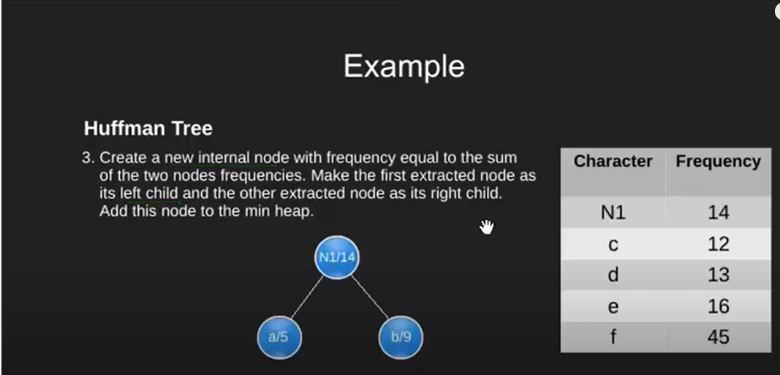

Slide 10
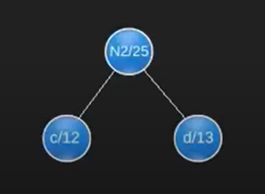
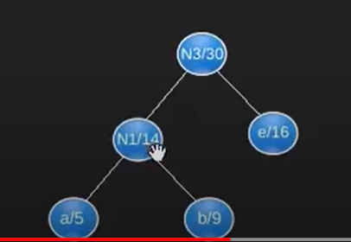
Step 3: Extract two minimum frequency nodes from heap.
Add a new internal node with frequency 12 + 13 = 25.
Step 4: Extract two minimum frequency nodes. Add a new internal node with frequency 14 + 16 = 30.
Character | Frequency
Internal Node | 14
e | 16
Internal Node | 25
f | 45
Character | Frequency
Inter Node | 25
Inter Node | 30
f | 45

Slide 11
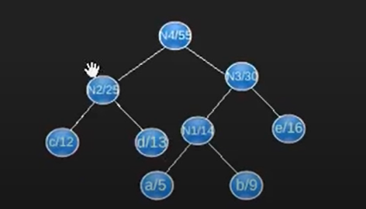
Step 5: Extract two minimum frequency nodes. Add a new internal node with frequency 25 + 30 = 55
Character | Frequency
f | 45
Internal Node | 55
Step 6: Extract two minimum frequency nodes. Add a new internal node with frequency 45 + 55 = 100
Character | Frequency
Internal Node | 100
Notes:
Ā

Slide 12
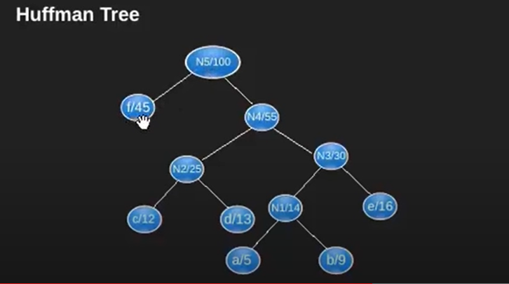

Slide 13
Steps to print codes from Huffman Tree:
Traverse the tree formed starting from the root. Create an empty array to store the codes of the nodes. While moving to the left child, write 0 to the array. While moving to the right child, write 1 to the array. Print the array when a leaf node is encountered.

Slide 14
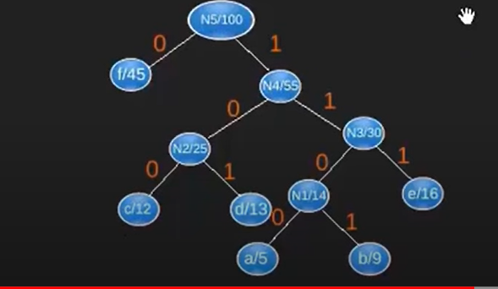
Using traversal, the encoded code becomes :
Character | Code-word
f | 0
c | 100
d | 101
a | 1100
b | 1101
e | 111

Slide 15
1100 1101 100

Slide 16
1100 1101 100 = a b c

